Slide 1
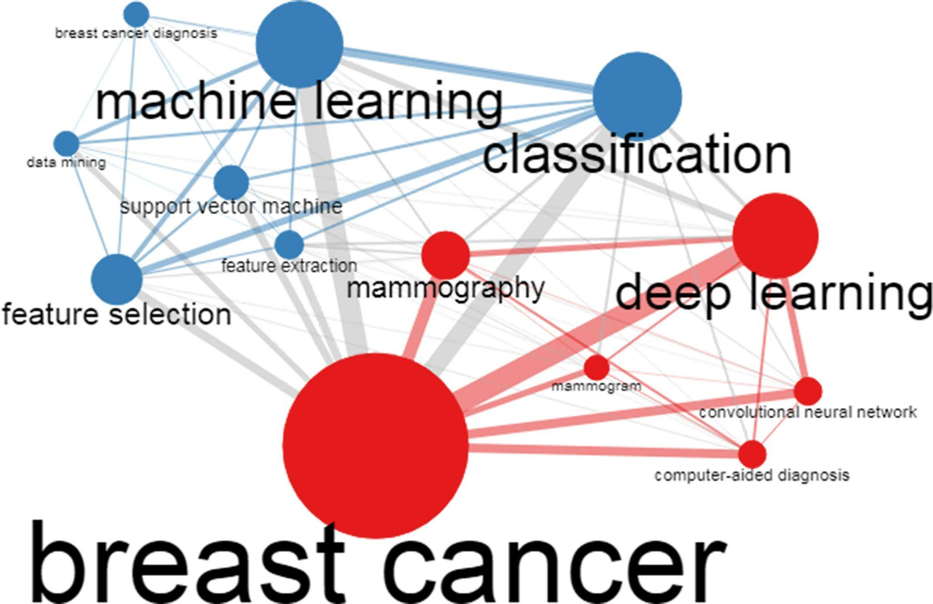
Novel ML approach for breast cancer diagnosis
Sabarish Suriya Swaminathan Ravichandran
/

Slide 2
Overview
Why is early detection of breast cancer is vital?
Breast Cancer Diagnosis DE-RBF-KELM Case 2
Two different dataset(Mammogram and Biopsy) and Data preprocessing
Why RBF-KELM and more about proposed Model
Different related classifiers were tested to compare the model
Breast Cancer Detection Case 2
Using common machine learning approach
Using optimized Ensemble learning framework and XAI
Comparing results of each models
Finally, Comparing the Two research paper to derive common goals and future prospects.

Slide 3
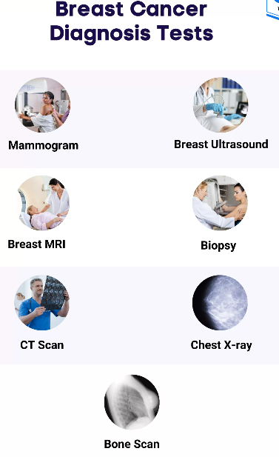
Important types of Diagnosis
Mammogram
The X-ray machine will take images of your breast from different angles.
Abnormal Results: May require further tests (ultrasound, MRI, biopsy).
Biopsy
A procedure to remove and examine breast tissue.
Confirms abnormality is benign or malignant and detect cancer type.

Slide 4
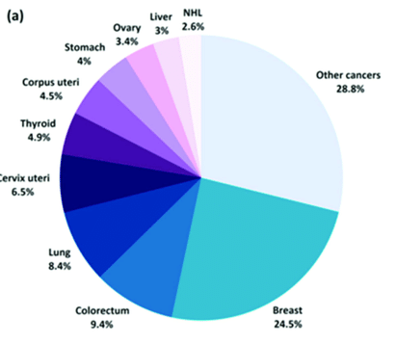
Case 1: A novel machine learning approach for breast cancer diagnosis
Global Impact and Importance of Early Detection
Breast cancer is a major global health issue, responsible for 24.5% of cancer cases among women.
Early detection is vital, boosting survival rates by up to 80%.
Why Machine Learning for Breast Cancer Diagnosis?
Traditional breast cancer detection methods can be slow and inaccurate.
Recent advances in machine learning, especially with explainable AI (XAI) and KELM, offer more accurate and reliable diagnosis.

Slide 5


What are the Datasets used?
MIAS Database (london,UK)
322 Mammogram images(Both left and right Breast)
207 Normal(N) & 115 Abnormal(A)
1024*1024 pixels size
Labeled by an expert radiologist that build on the experience and biopsy.
Wisconsin Breast Cancer Diagnostic (WBCD)
569 Different Instances from biopsy
63% benign and 37% malignant
30 Attributes

Slide 6
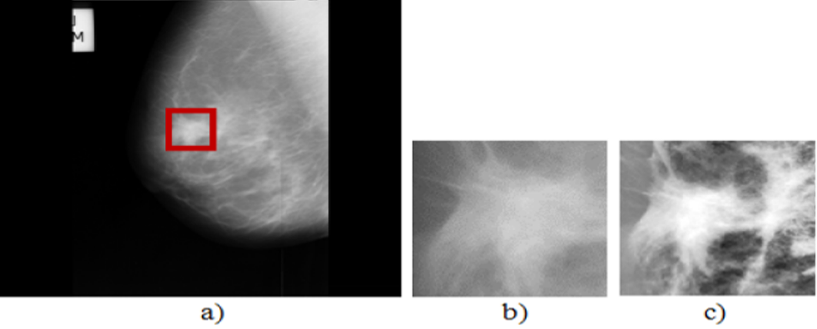
Data Preprocessing
Unwanted regions must be removed to extract real region of interest(ROI) Eg. pectoral muscle, artifacts and imaging noise.
This requires two steps:
Cropping operation. How?
Position and radius info given already, with that manual cropping of abnormal images is done
Reduced to 127*127 pixel
Now, selected images are of low contrast, so it is required to enhance the contrast
CLAHE(Contrast Limited Adaptive Histogram Equalization) is used to enhance the quality of low contrast images.
Enhancement results for mammogram image: A)Original mammography,
B) The corresponding ROI, C) the corresponding enhanced ROI
CLAHE divides the image into smaller regions (called tiles)
applies histogram equalization independently

Slide 7
Feature Extraction Based On DCT(Discrete Chebyshev Transform)
What is DCT?
Precise features of representation capability for given image.
Also used for recognition and classification
3 steps and applications
Chebyshev polynomials are used to project the image data.
chebyshev moments are computed to capture the alignment of the image with these polynomials.
The feature Vector F(k) is then created to represent the texture properties of the image.
This method enables efficient and precise feature extraction for analyzing the MIAS dataset..

Slide 8
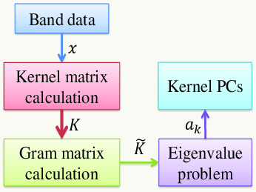
Dimensionality Reduction with KPCA
Kernel PCA handles non-linear data and complex structures.
In KPCA, the input data X = [x1, x2, ⋯, xn]T is first normalized to have zero mean and unit variance. Then, it is mapped into high-dimension using non-linear function φ(x).
The Kernel Trick uses a function ( k(x,x') to create a Gram Matrix, simplifying covariance computation in high-dimensional space.
KPCA performs eigenvalue decomposition on the Gram matrix, enabling PCA in high-dimensional space for non-linear dimensionality reduction.
In this work, KPCA method is used to reduce the size of the image.

Slide 9
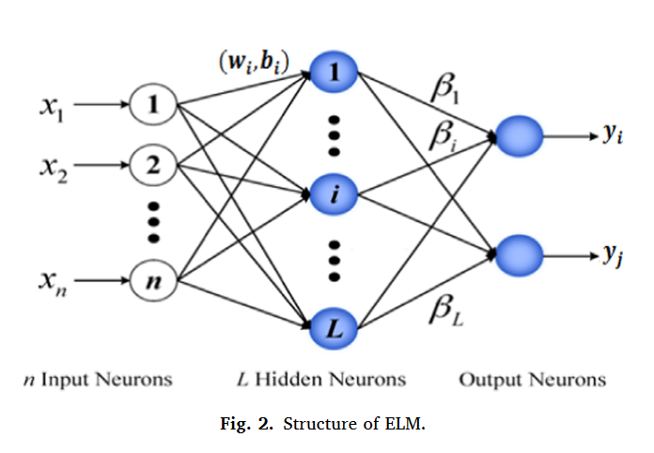
Kernel Extreme Learning Machine
ELM :
ELM is a type of single hidden layer feed-forward network(SLFN)
It’s objective is to get output weights by solving the equation :
Hβ = Y⇒β = H+Y
Why KELM?
ELM dead nodes with close to zero input weights, reducing impact and causing mapping errors, especially for non-linear samples.
KELM non-linearly separable data into linearly separable data
KELM uses Kelm as it’s output function in which it’s independent of the network architecture and can be any kernel function.

Slide 10
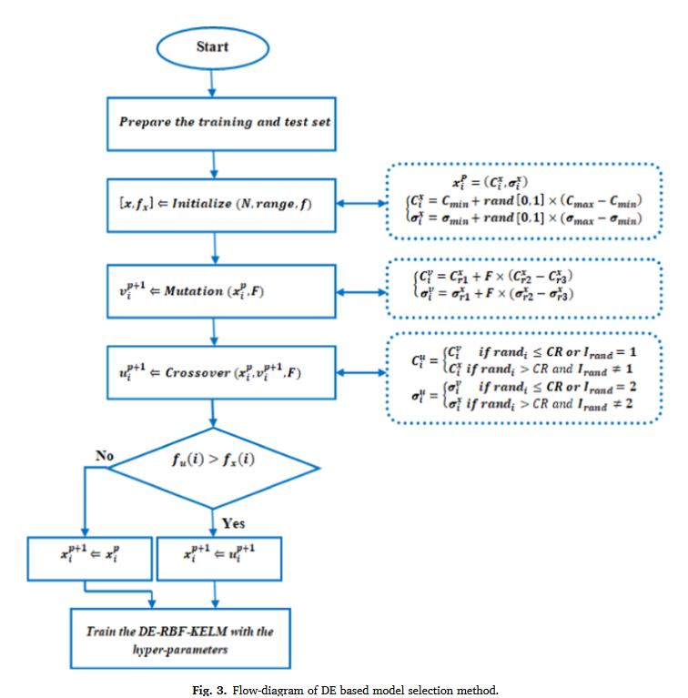
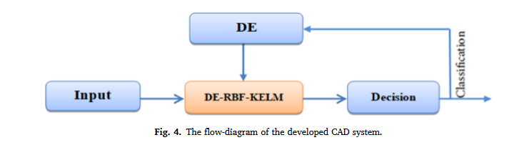
Proposed DE_RBF_KELM
It is a Metaheuristics approach which means they make few or no assumption.
Parameters illustrated in the flowchart are:
No.of .individual population(NP), the crossover rate (CR), the mutation Scale factor(F), the search space limits(range), and cost function to solve the prob(f)
The DE algorithm continues iteration until hyperparameter of the RBF-KELM are optimized to achieve the best performance,

Slide 11
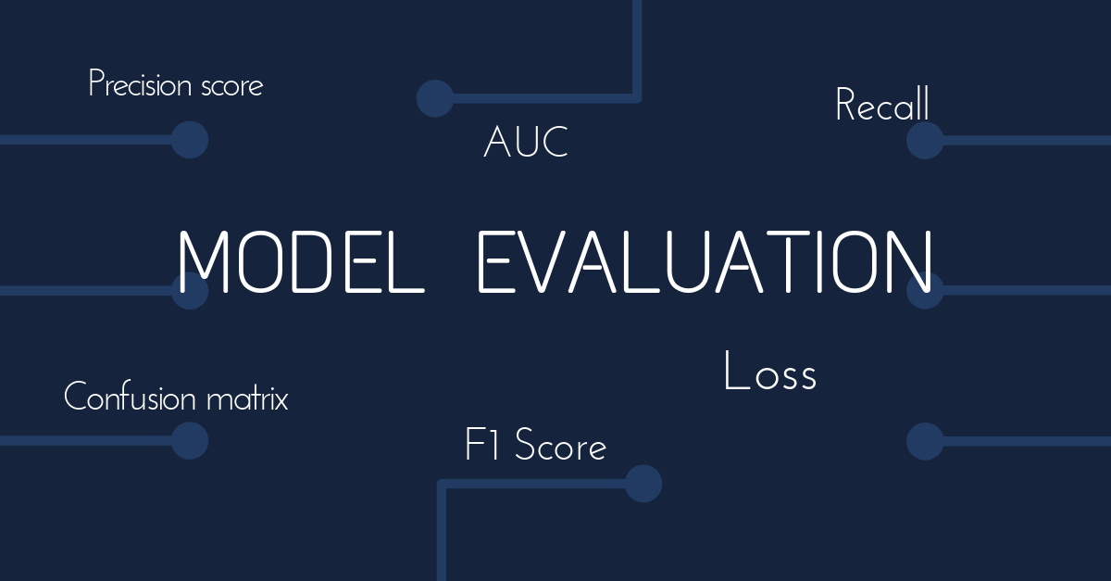
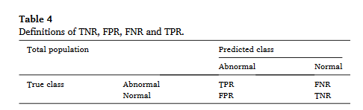
Performance Measures
sensitivity.
specificity,
F-score
Accuracy
Area under the receiver operating characteristics(ROC curve) Called AUC.
These different performance measures are calculated using to the entities TNR, FPR, and this table

Slide 12
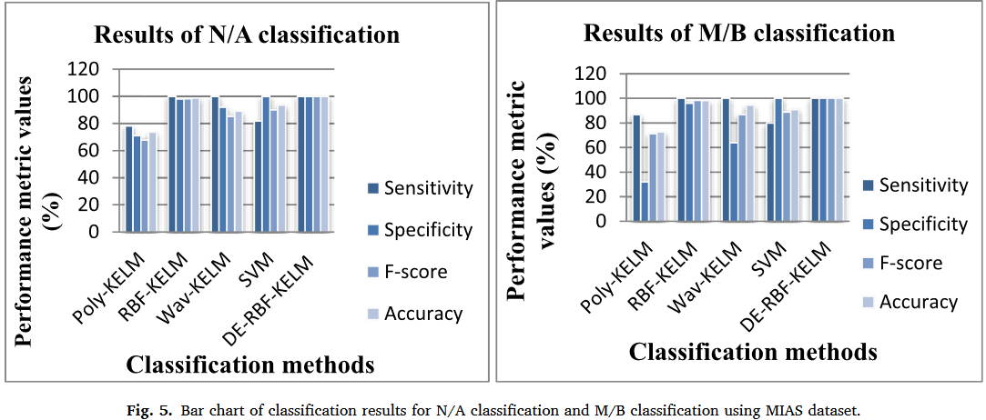
Results: Validation on the MIAS dataset
comparison of methods SVM, Poly-KELM, Wav-KELM, and RBF-KELM using the MIAS database for N/A and M/B classification are shown in Fig. 5.

Slide 13
Interpretation
Results of N/A Classification
Results of M/B Classification
Methods | Accuracy | Sensitivity | specificity | F-score
DE_RBF_KELM | 100% | 100% | 100% | 100%
RBF-KELM | 98.06% | 100% | 98% | 98.21%
Poly-KELM | 58.02% | 78.18% | 71% | 67.72%
Wav-KELM | 98.71% | 100% | 92% | 85.22%
SVM | 95.56% | 81.81% | 100% | 90%
Methods | Accuracy | Sensitivity | specificity | F-score
DE_RBF_KELM | 100% | 100% | 100% | 100%
RBF-KELM | 98.18% | 100% | 96% | 98.36%,
Poly-KELM | 72.7% | 86.76% | 32% | 71.23%
Wav-KELM | 94.54% | 100% | 64% | 86.95%
SVM | 90.9% | 80% | 100% | 88.89%
As this table shows, the best result of the suggested DE-RBF-KELM method is 100% using optimal Kernel-function parameter values C and sigma (σ).

Slide 14
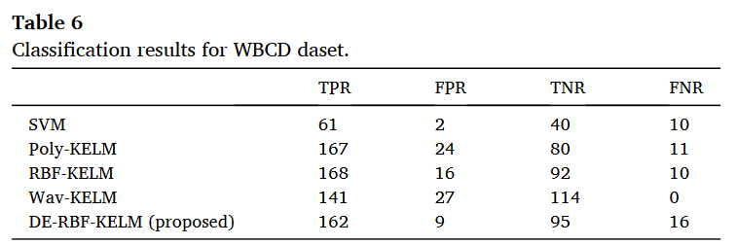
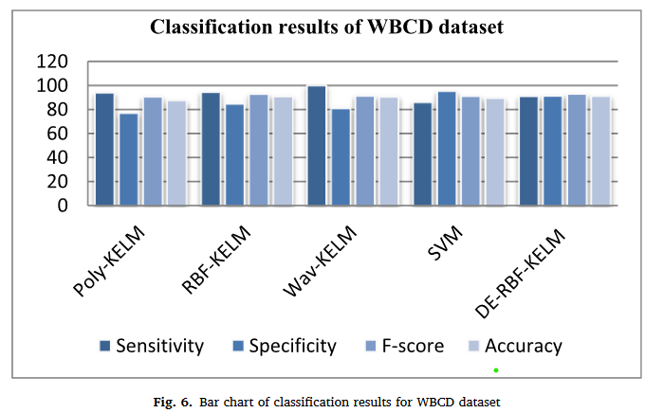
Experiment II: Validation on the WBCD dataset
Methods | Sensitivity | specificity | F-score
DE_RBF_KELM | 91.34% | 91.01% | 92.83%
RBF-KELM | 94.83% | 84.61% | 92.81%
Poly-KELM | 93.82%, | 76.92% | 90.51%
Wav-KELM | 100% | 80.85% | 91.26 %
SVM | 85.91% | 95.23% | 91.04%
The DE_RBF_KELM algorithm outperforms the RBF_KELM algorithm and obtains the best performance from the table and the figure

Slide 15
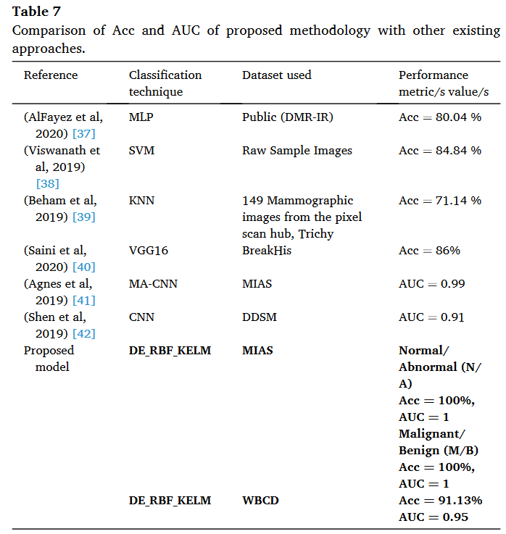
To demonstrate the superiority of the suggested model over some of the recently CAD systems, a detailed comparison is summarized in Table .
performances are also better compared to previous studies using different data sets. The DE-RBF-KELM method proposed in this study shows better diagnostic aid.

Slide 16
Limitation and Conclusion
Conclusion and Future work.
Introduced a novel mammogram classification method using the differential evolution (DE) algorithm to optimize RBF-KELM.
Preprocessing enhanced image quality, followed by DCT and KPCA for feature extraction and reduction.
DE-RBF-KELM outperformed other classifiers in accuracy, specificity, and sensitivity.
Future work: Develop portable devices for automatic breast cancer classification and explore RBF-KELM and CNN integration.
N/A classification in MIAS took longer than M/B.
Study could be covered all eligible mammograms across institutions.
WBCD data lacked complete breast cancer risk assessment.
ML can assist when lymph node abnormalities are undetectable.

Slide 17
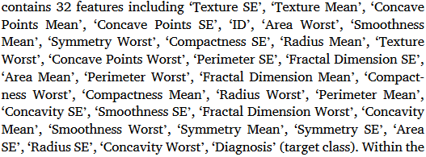
Case 2: A novel approach for breast cancer detection using optimized ensemble learning framework and XAI
This research applies supervised machine learning models to detect breast cancer, aiming to assess their performance.
Dataset used:
“Wisconsin Breast Cancer Dataset”
UCI machine learning repository(public accessible)
30 features EG. Smoothness mean, Radius Mean
45% Malignant and 55% Benign
real-world medical challenge
Numeric, nominal and binary

Slide 18
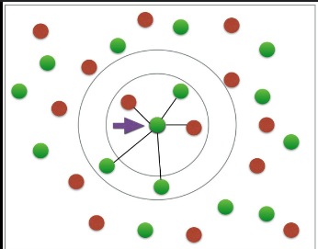
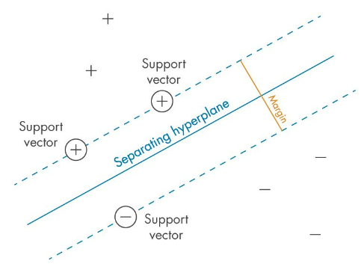
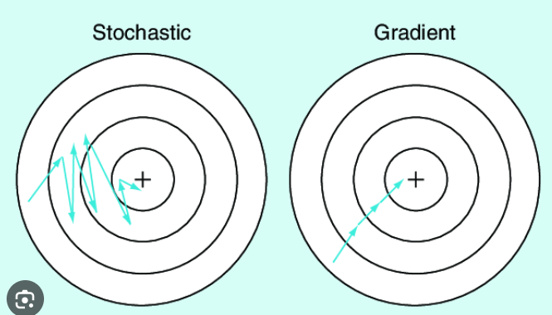
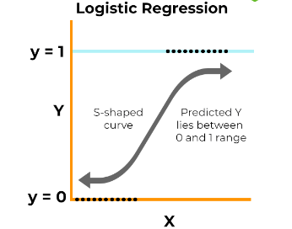
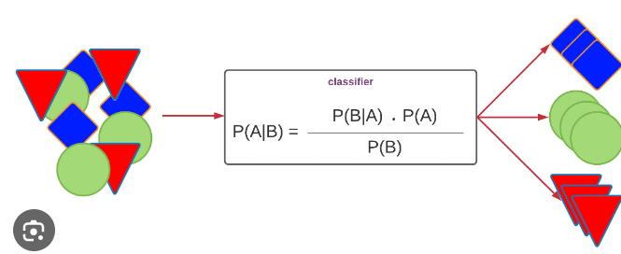
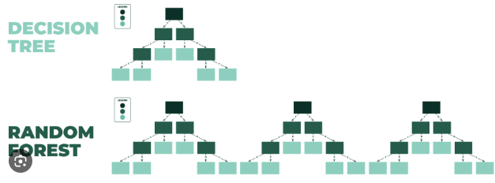
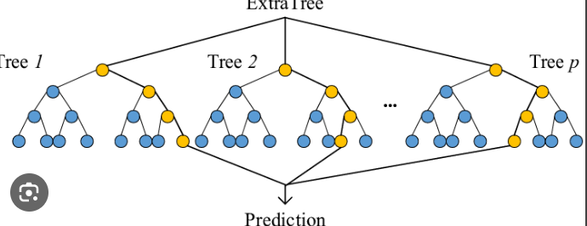
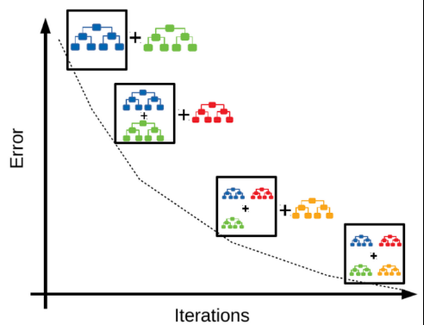
9 Machine learning models for breast cancer prediction
Random Forest
Decision Tree
K-nearest Neighbor
Logistic Regression
Gradient boosting machine
Support Vector Machine
Extra tree classifier
Gaussian Naive Bayes
Stochastic Gradient Descent.
Notes:
Random Forest
Random Forest (RF) stands as a prevalent ensemble learning tech-
nique in machine learning, extensively applied for classification and
regression tasks [33,34]. It operates by amalgamating multiple decision
trees, wherein each tree’s outputs contribute to the ultimate prediction.
The core principle involves training numerous decision trees, each on a
distinct subset of the data, and subsequently amalgamating their pre-
dictions to derive the final output.
3.2.2. Decision Tree
Decision Trees (DT) stand among the most prevalent methods for
classification and prediction [35]. Represented as a tree-like structure
akin to a flowchart, a DT showcases logical steps. Within this structure,
internal nodes portray attribute tests, branches signify attribute test
outcomes, and leaf nodes indicate class labels. Decision trees offer sig-
nificant advantages in data classification, executing this task swiftly and
with minimal computational demands.
3.2.3. K-nearest neighbor
The k-NN algorithm, a non-parametric method in machine learning
applicable to regression and classification tasks, operates through lazy
learning or instance-based learning [36]. It identifies the k closest
training instances to a new data point and determines the majority class
among these k neighbors to classify the new data point. Grounded on the
similarity concept between input and training data, the algorithm stores
all available cases and employs a similarity measure, often a distance
function, to classify new cases. Renowned for its simplicity, the k-NN
algorithm proves straightforward and easily implementable.
3.2.4. Logistic Regression
Logistic Regression (LR) serves as a statistical model employed in
supervised learning specifically for binary classification problems. Its
prevalent use occurs when the outcome variable is binary, such as pre-
dicting the presence or absence of a disease in a patient, or determining
if an email is spam or not. LR aims to gauge the probability of a binary
outcome considering specific inputs, utilizing this estimation for pre-
dictions. Employing the logistic function, also known as the sigmoid
function, LR models the probability of a binary outcome, utilizing the
resulting output to make predictions [33,37].
Table 1
Summary of the discussed research works.
Ref. Models Dataset Achieved accuracy
[17] Baseline models
and transfer
learning models
(VGG16 and
Inception V3)
PROENG dataset 93.1% without
augmentation; 98.5%
with augmentation
with Inception V3
[18] k-NN, SVM, GB,
GNB, DT, RF, LR,
ADA, and LDA
Wisconsin Breast Cancer
dataset
98.23% with AB
[20] LR, KNN, SVM,
CNN variants
Kaggle 162 H&E 87% CNN model 3;
78.56% SVM
[21] RF, KNN, DT, SVM,
LR, GBM, proposed
(LR + SGD)
Breast Cancer Wisconsin
Dataset
100% with (LR + SGD)
[24] Deep Learning
based model (DLA-
EABA)
https://wiki.
cancerimagingarchive.
net/
97.2% using DLA-
EABA
[25] ResNet, Inception-
V3Net, and
ShuffleNet
BreakHis 99.7% for binary
classification with
ResNet; 97.81% for
multi-class using
ResNet
[26] RF, k-NN, DT, SVM,
NB, XGBoost, ADA
Wisconsin breast cancer
Dataset
98.24% using XGboost
[27] CNN, DNN, LSTM,
GRU, BiLSTM,
CNN-GRU
Histopathologic Cancer
Detection
86.21% CNN-GRU
[22] DT, SVM, RF, LR, k-
NN, NB and
rotation forest
The University of
Wisconsin Hospital
dataset
98.1% using logistic
regression
[23] EfficientNet-B5,
DenseNet-169
Hallym University Sacred
Heart Hospital dataset
88.1% DenseNet-169
R.M. Munshi et al.
Image and Vision Computing 142 (2024) 104910
43.2.5. Support Vector Machine
The Support Vector Machine (SVM), a recognized supervised
learning algorithm [38], is employed in machine learning for classifi-
cation and regression purposes. SVM’s core principle revolves around
identifying the optimal boundary, referred to as a hyperplane, that
segregates data points into distinct classes. This boundary is constructed
to maximize the margin, representing the distance between the bound-
ary and the nearest data points from each class, often referred to as
support vectors. SVM demonstrates applicability to both linear and non-
linear classification tasks.
3.2.6. Gradient boosting machine
GBM stands as a machine learning algorithm employed for classifi-
cation and regression tasks, falling under the boosting ensemble learning
family [39]. GBM amalgamates forecasts from multiple weak models,
like decision trees, to generate a robust model. The essence of gradient
boosting involves iteratively training weak models, such as decision
trees, and sequentially integrating them into the ensemble. Each new
tree is trained to rectify the errors made by the preceding trees, focusing
on the training instances that were previously misclassified. The pre-
dictions from all trees are amalgamated to derive the ultimate
prediction.
3.2.7. Extra tree classifier
ETC operates as an ensemble learning technique employing ran-
domized trees to produce a conclusive classification outcome by amal-
gamating independent trees within a decision tree forest [40]. Its
foundational idea aligns with RF, yet ETC diverges in constructing de-
cision trees within the forest. In ETC, decision-making involves
randomly selecting a subset of the top K features and determining the
optimal solution using the Gini index. This methodology guarantees the
creation of uncorrelated trees within ETC. Gini feature importance as-
sumes a pivotal role in the process of feature selection.
3.2.8. Gaussian Naive Bayes
GNB is a popular machine learning technique that is used for clas-
sification tasks based on Bayes’ Theorem. The likelihood of a hypothesis
(class label) given particular evidence (feature values) equals the like-
lihood of the evidence given the hypothesis multiplied by the prior
probability of the hypothesis, according to this theorem [41]. The word
‘naive’ in GNB refers to the algorithm’s strong premise, known as class
conditional independence, which states that while the class name is
known, all characteristics are independent. Although this assumption
seldom matches real-world conditions, the method frequently gives
reliable results in actual applications.
3.2.9. Stochastic gradient decent
SGD serves as an optimization algorithm employed to reduce a
function, especially during model training in machine learning appli-
cations like linear regression, logistic regression, and neural networks
[42]. It represents a derivative of the gradient descent (GD) algorithm
and earns its stochastic nomenclature due to utilizing a random data
subset, termed a mini-batch, for estimating the gradient at every itera-
tion. The primary objective of the SGD algorithm revolves around
adjusting the model parameters in a direction contrary to the gradient of
the loss function concerning the parameters, employing a constant step
size designated as the learning rate.

Slide 19
Deep learning models for breast cancer prediction
Multilayer Perceptron neural network(MLP)
optimal for small dataset.
Input,output and hidden layer(weight assignment is performed)
Convolutional Neural Network(CNN)
study uses a CNN with eight layers (convolutional, max-pooling, and dense) for image analysis.
Suitable for Medical Classification
Pooling Efficiency by sharp features and handles flat features.
Long short term memory(LSTM)
LSTM improves on RNNs by handling long-term sequences and
preventing the vanishing gradient issue.
Key Gates are input, forget, and output gates..

Slide 20
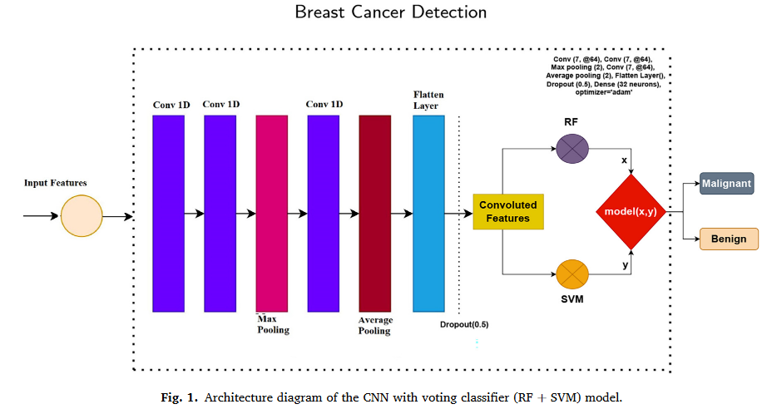
Architecture of CNN for Feature extraction
Embedding Layer
Size of 20,000 and output dimension of 300, processes input data
Convolutional Layer:
Equipped with 5000 filters and a 2×2 kernel, this layer applies the ReLU activation function.
Max Pooling Layer: This layer uses a 2×2 size to extract significant feature maps from the output of the convolutional layer.
Flattening Layer: Converts the output into a 1D array, making it suitable for input into learning models for prediction.

Slide 21
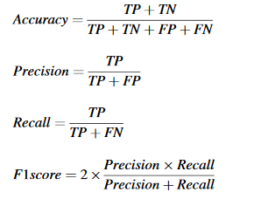
Transfer Learning Model and Evaluation metrics
U-Net Overview :U-Net, designed for biomedical image segmentation, excels with limited training data using a two-pathway architecture.
Precise Segmentation It preserves input image resolution, delivering accurate segmented outputs.
MobileNet Efficiency: Reduces computational complexity with depthwise-separable convolutions, suited for mobile devices.
Adjustable Design Uses a resolution multiplier "w" to optimize performance and efficiency.
Evaluation Metrics:
Accuracy, Precision, recall and F1 score is considered.

Slide 22
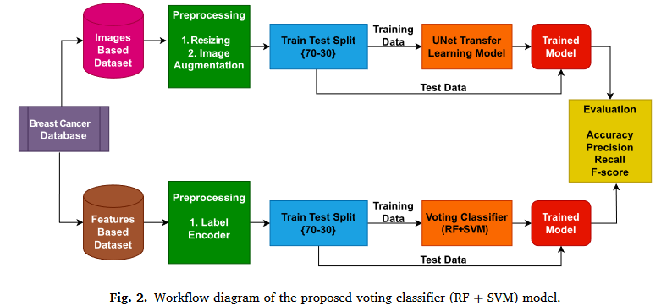
Methodology proposed for numerical data features
What is Voting Classifier?
It uses the soft voting criterion to merge RF and SVM
Class with greatest number determines the final forecast.

Slide 23
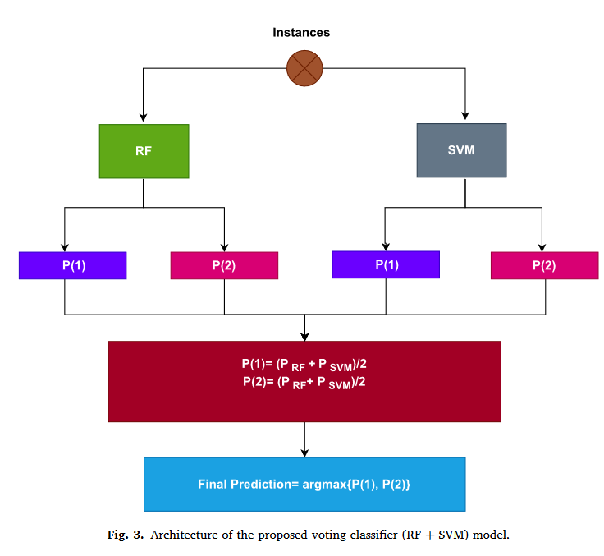
Ensemble Voting Classifier
Both the Random Forest and SVM models are trained independently
each model makes predictions on new data
Ensemble Voting Classifier then combines these predictions
the class that appears most frequently among the models' predictions is chosen.
overall classification performance and robustness.
Notes:
An Ensemble Voting Classifier combines multiple models to improve prediction accuracy by leveraging the strengths of each. Here's how it works for combining a Random Forest and a Support Vector Machine (SVM):
1. **Training Models**: Both the Random Forest and SVM models are trained independently on the same dataset. The Random Forest creates an ensemble of decision trees, while the SVM finds a hyperplane that best separates classes.
2. **Voting Mechanism**: After training, each model makes predictions on new data. The Ensemble Voting Classifier then combines these predictions:
- **Majority Voting**: The most common class prediction from the models is selected as the final output. For instance, if the Random Forest predicts Class A and the SVM predicts Class B, the class that appears most frequently among the models' predictions is chosen.
This approach benefits from the diverse strengths of each model, enhancing overall classification performance and robustness.

Slide 24
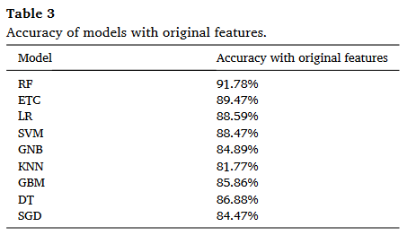
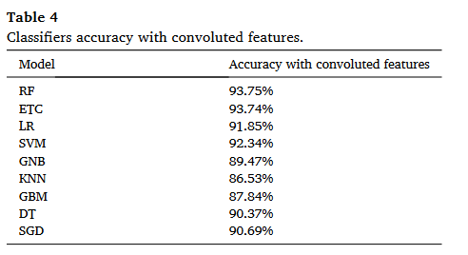
Results: Comparing Individual machine learning models on original and convoluted features
Original Features
Convoluted features

Slide 25
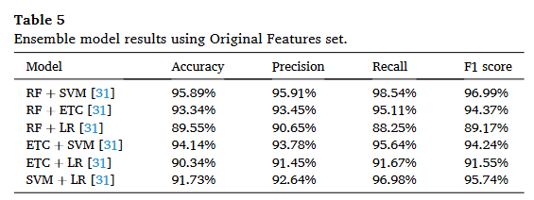
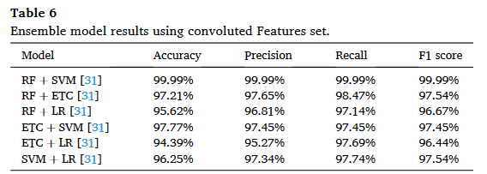
Performance of ensemble model on convoluted features
19/08/2024

Slide 26
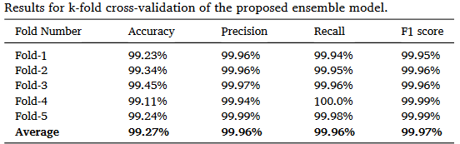
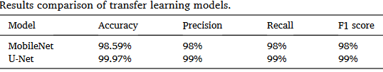
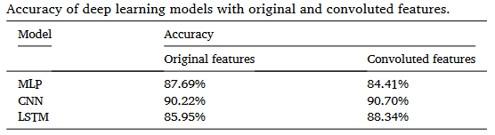
5-fold Cross-validation approach
Comparison transfer learning models
Deep learning model performance
UNet model exhibits superior performance overall.

Slide 27
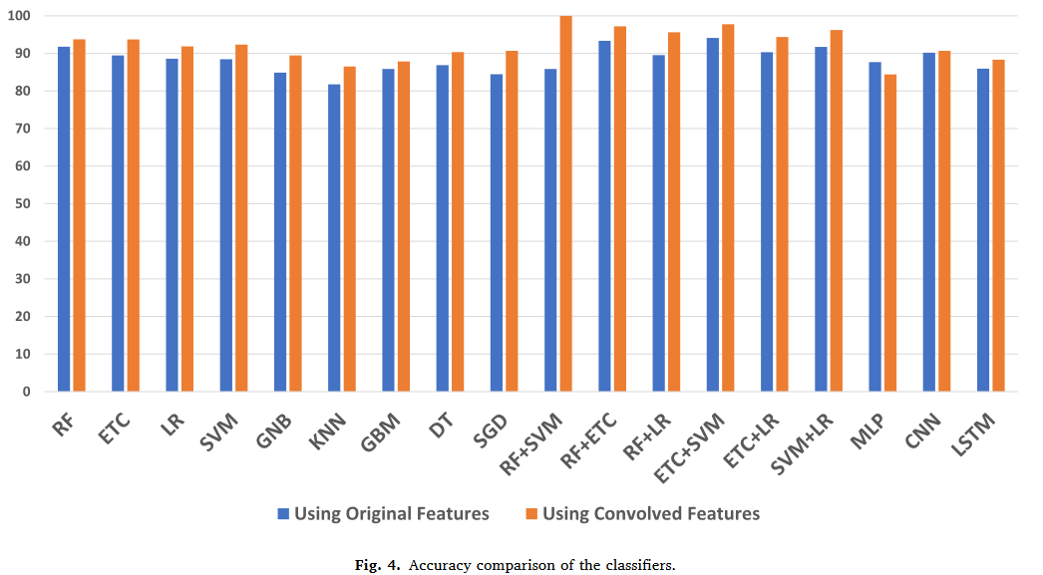
Significance of the proposed Model
Two further dataset were analysed.
Breast cancer Survival which contain 330 patient with including tumor stage,type,etc..,
second dataset contains 10 Quantitative features with similar attributes.117 patient
proposed model obtained 97.34% accuracy on the 1st dataset and 96.67% accuracy on the 2nd dataset.
Notes:
In order to validate the performance of the proposed model, we
tested it on two further independent datasets. The first dataset [56] is
‘Breast Cancer Survival’, which contains 330 patient records with the
feature Patient_ID, Age, Gender, and expression levels of four proteins
(Protein1, Protein2, Protein3, Protein4). The dataset also includes the
Breast cancer stage of the patient (Tumor_Stage), Histology (type of
cancer), ER, PR, and HER2 status, Surgery_type, Date of Surgery, Date of
Last Visit, and Patient Status (Alive/Dead). The second dataset [57]
contains 10 Quantitative features to show the presence or absence of
breast cancer in a patient. The features are Age (years), BMI (kg/m2),
Glucose (mg/dL), Insulin (μU/mL), HOMA, Leptin (ng/mL), Adiponectin
(μg/mL), Resistin (ng/mL), MCP-1(pg/dL), and Labels (absence or
presence). Fig. 4 presents the accuracy comparison of the classifiers used
in experiments. The proposed model obtained 97.34% accuracy on the
first dataset and 96.67% accuracy on the dataset which greatly shows
the stability of the proposed model on all kinds of datasets. Important
terms are explained in Table 13

Slide 28
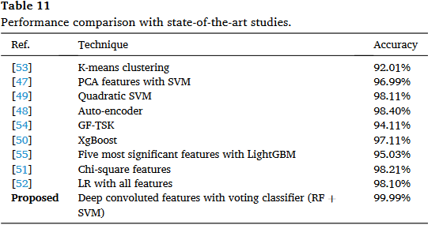
Performance comparison with existing studies
A meticulous selection process was employed to identify the nine most relevant research articles.
Results underscore the superior performance of the proposed model.

Slide 29
Conclusion and Future work
Conclusion
Novel Framework with High Precision:
explainable AI (XAI) combining image and numeric data(U-Net)
ensemble model integrating CNN-derived features with Random Forest and SVM classifiers.
Comprehensive Evaluation and Validation:
comparative analysis and K-fold cross-validation
compared to state-of-the-art model
This approach enhances early detection and patient outcomes, reducing breast cancer mortality.
Limitations
Size of the data. More data could better the model
Datasets from different sources or demographics could help robustness or generalizability.
The computational resources
Future work
Plan to apply our model to a variety of datasets, like different domains,and explore microscopic characteristics in these images.

Slide 30
Compare and Contrast
 | Case 1: ML approach for BC Diagnosis | Case 2: BC detection ensemble learning framework and XAI
Datasets: | MIAS (Mammogram) and WBCD Dataset (30 features) | WBCD Dataset(30 features along with Image data)
Preprocessing | CLAHE and KPCA were used for feature extraction | CNN techniques were used to extract convoluted features.
Methods proposed | DE_RBF_KELM | UNet Transfer Learning Model XAI, Voting classifier(RF+SVM)
Results: | Proposed DE_RBF_KELM outperformed other model compared with the accuracy of 100% in a method. | Proposed ensemble framework (Voting classifier(RF+SVM) and XAI dominated other model with significant scores
Future Work | Develop portable devices for automatic breast cancer classification and explore RBF-KELM and CNN integration. | Plan to apply our model to a variety of datasets. eg.different domains and explore microscopic characteristics.

Slide 31


Slide 32
Any questions?

